Slide 1
3D Stereographic Images
Photo 2

Slide 2
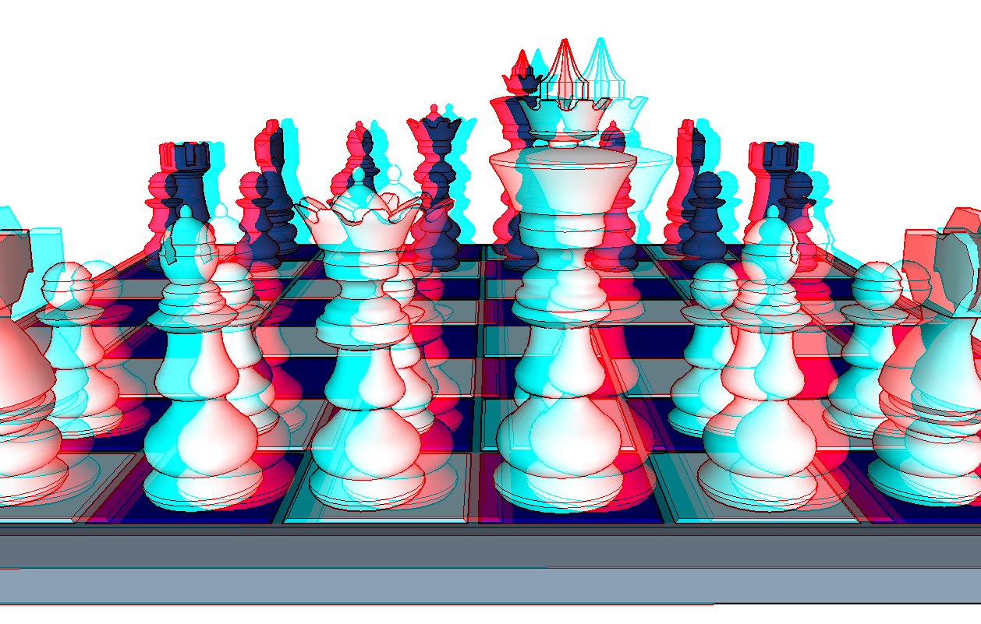
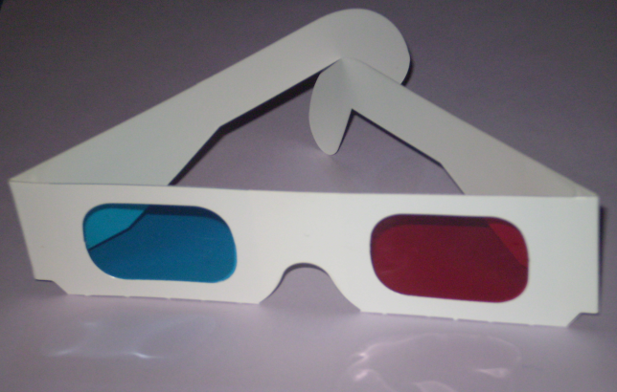
What is it?
Anaglyph 3D is the name given to the stereoscopic 3D effect achieved by means of encoding each eye's image using filters of different (usually chromatically opposite) colors, typically red and cyan.
Anaglyph 3D images contain two differently filtered colored images, one for each eye. When viewed through the "color-coded" "anaglyph glasses", each of the two images reaches one eye, revealing an integrated stereoscopic image. The visual cortex of the brain fuses this into perception of a three dimensional scene or composition.

Slide 3
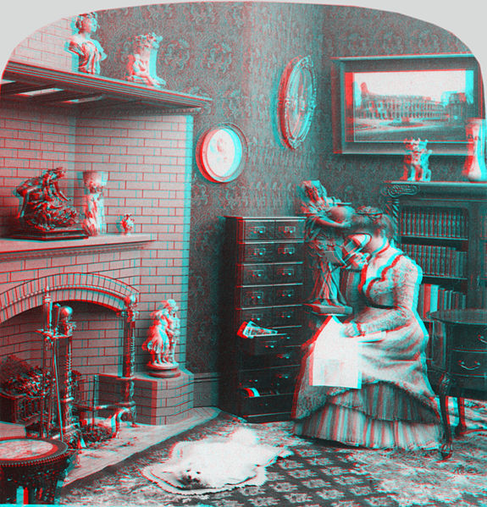

Slide 5
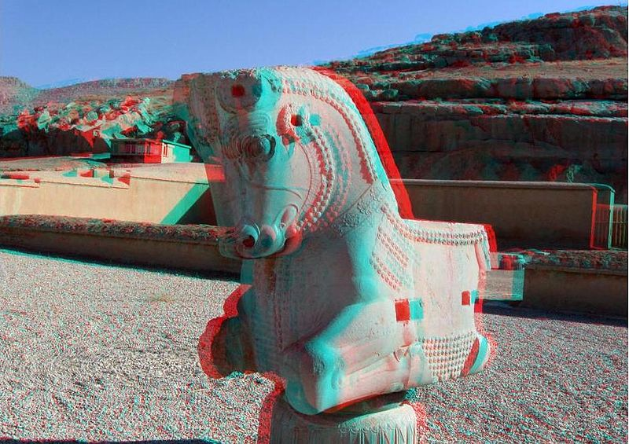

Slide 8
Recently…
Video games, theatrical films, DVDs
Practical images, for science or design, where depth perception is useful, include the presentation of full scale and microscopic stereographic images.

