Slide 1
Final Task
Photo 2

Slide 2
Project overview
You will select a CONCEPT and CREATE a series of images that communicate your concept
You will need to PLAN for each shot
Answer a series of QUESTIONS to prepare
Shoot FIVE images that function as a SERIES
Present your series and answers to the class

Slide 3
7 Questions to answer…
Concept: What is the overall theme of your series?
Message: What are you saying about that theme/concept?
Audience: Who are you speaking to?
Emotional connectors: In what ways can you cause your story to resonate best with your audience?
Creative composition: How are the elements within the frame organized?
Dynamic artistry: What choices will you make in terms of camera angle, type of lighting, color, venue, depth, and motion…all such factors will influence the overall outcome of your concept shot.
Story telling quality: In one image, does your concept tell the complete story? A picture is worth a thousand words, so one image can capture depth of story. It will simply take some time in thought, and some well developed shots.

Slide 4
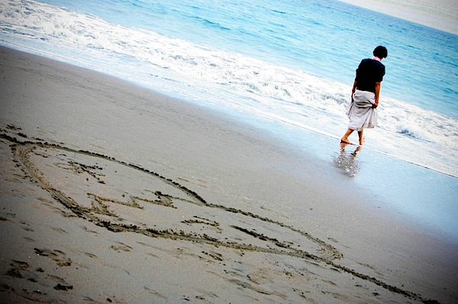
Let’s analyze one together

Slide 5
What is the concept?
What is the message?
Who is the audience?
Notes:
Concept= Love
Message= Broken heart
Audience= twenties, young people

Slide 6
What is the emotional connector?
What is the creative composition?
What is the dynamic artistry?
What is the story telling quality?
Notes:
Emotional connector– feeling of aloneness
Creative Composition– low camera angle (taken from the ground) makes you look at the heart and then the girl
Dynamic artistry: The heart dominates 2/3 of the image but the attention is equally as interesting on the girl because of the vibrant blue of the ocean
Storytelling quality? Does this single image describe the feelings, the experience, and the hurt of a broken heart?

Slide 7
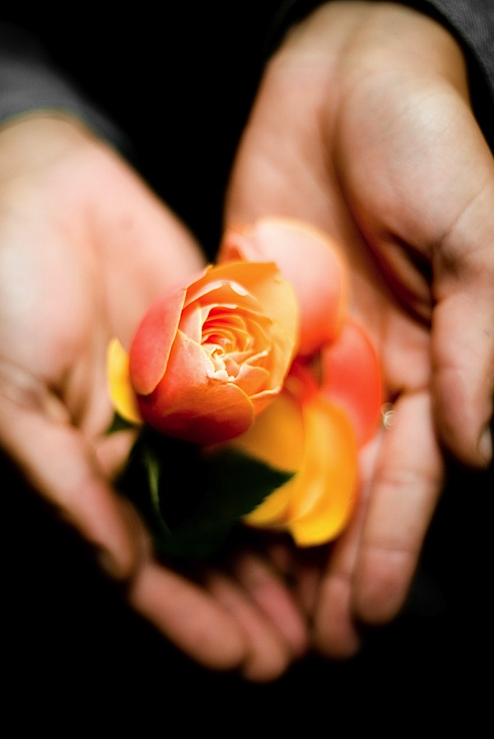
What is the concept?
What is the message?
Who is the audience?
Notes:
Concept: love
Message: true love, precious love
Audience: universal

Slide 8
What is the emotional connector?
What is the creative composition?
What is the dynamic artistry?
What is the story telling quality?
Notes:
Emotional connector: Beauty of the flower, delicacy/preciousness
Creative composition: taken from above– perspective enhances the emotional aspects
Artistry: Depth of field adds emphasis to the rose but the hands are still visible. Blackened background doesn’t distract
Storytelling quality: Does this single image describe the feelings, experience and precious value of true love?

Slide 9
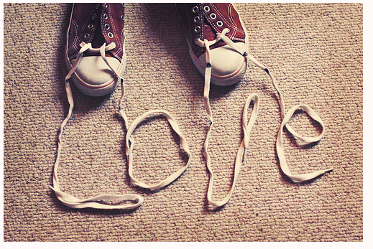
What is the concept?
What is the message?
Who is the audience?
Notes:
Concept= Love
Message= Is it clear? Love can twist you up? Love can unravel you? Love makes you carefree?
Audience= young audience

Slide 10
What is the emotional connector?
What is the creative composition?
What is the dynamic artistry?
What is the story telling quality?
Notes:
Emotional connector?
Creative composition? Words written in strings
Dynamic artistry: Cropped feet enhance universality, angle looking down feels sweet
Storytelling quality: Does this image need more to convey a story or fully understand the concept?

Slide 11
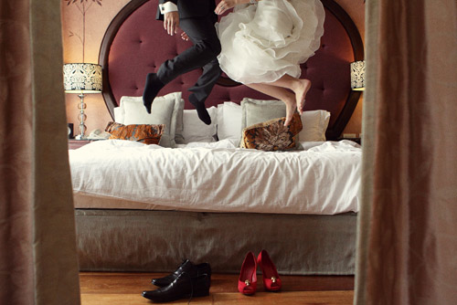
What is the concept?
What is the message?
Who is the audience?

Slide 12
What is the emotional connector?
What is the creative composition?
What is the dynamic artistry?
What is the story telling quality?

Slide 13
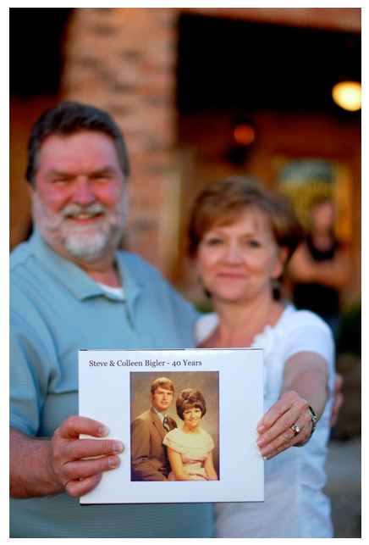
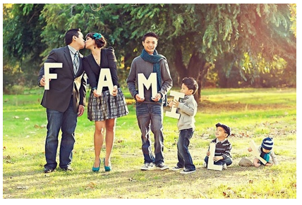
If Love was your selected concept…
What would you do next?

Slide 14
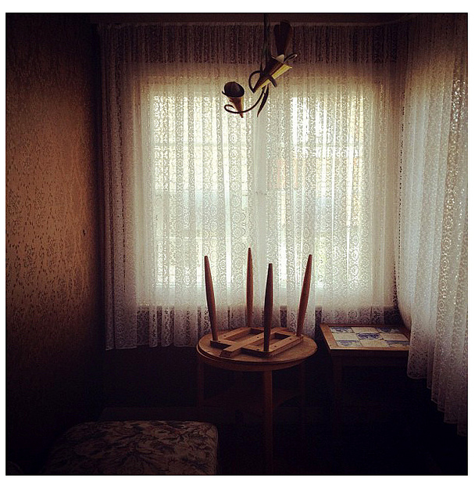
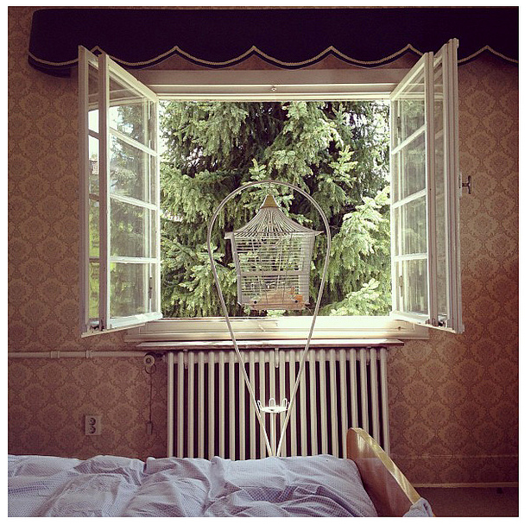
What is your concept?

Slide 15
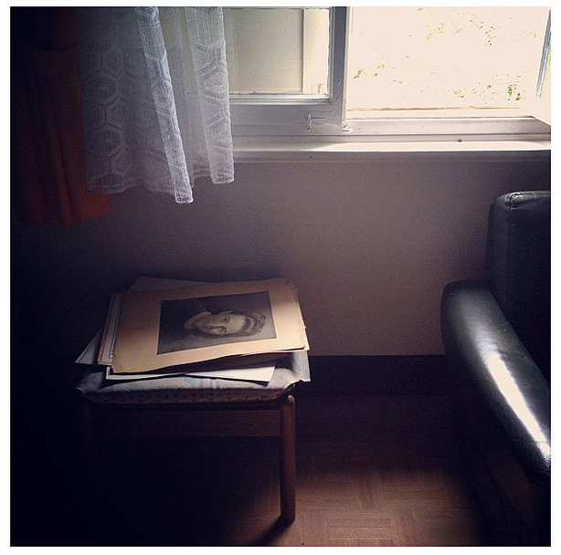
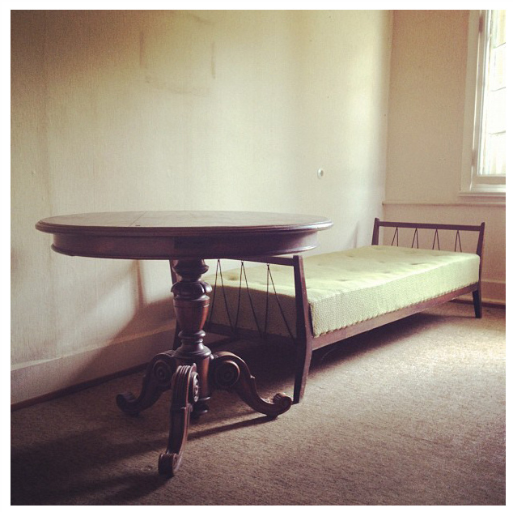

Slide 16
Where to start?
Brainstorm concepts
Use websites- flickr, pinterest:
Concept photography
Themed photography

